Slide 1
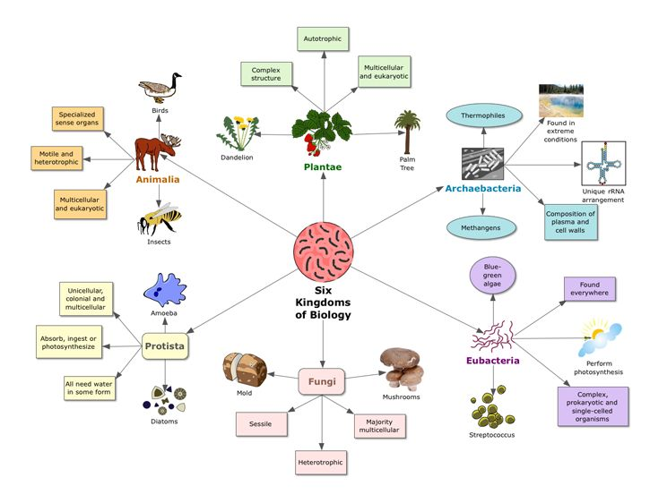
2022 Year 7 Science Classifications Week 1
Written By Miss Serafino

Slide 2
Lesson Objectives
History of Classifications
→ Scientists which assisted the development of the classification system
→ The classification hierarchy utilised within today's society is derived from Linnaean classification system
Classifications Hierarchy
→ 7 classifications ““King Philip Crawled Over Four Gooey Snails”
Scientific Names
→Dichotomous Key →Linnaeus’s Double-Name ‘Binomial’ System

Slide 3
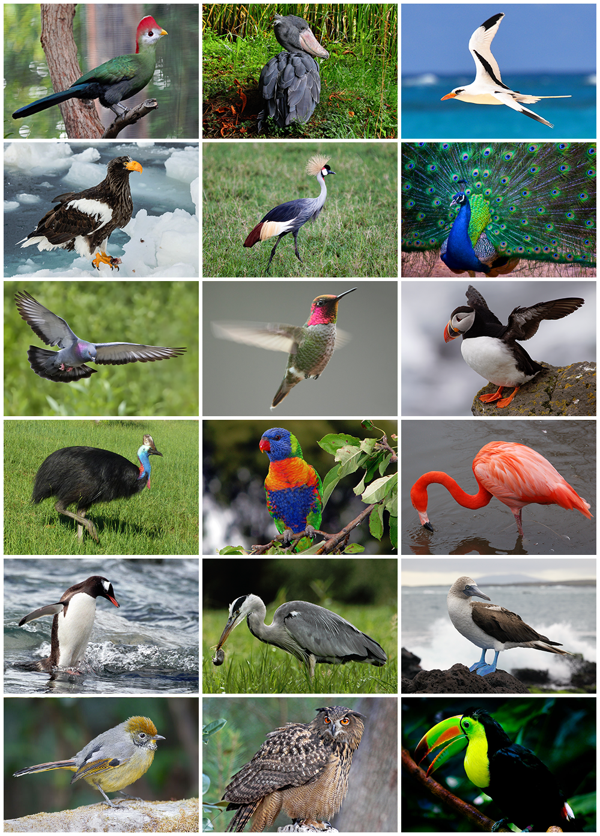
History of Classification
Early humans had to rely on hand-drawn pictures and verbal descriptions when they discovered a new plant or animal
Overtime classification systems were developed to help scientists communicate with each other despite their different locations and languages
Within todays society, the classification of systems continues as new plants or animals discovered by humans are categorised into the hierarchy and put into groups
* Student Task: Copy down the information above *

Slide 4
History of Classification
Aristotle (384-322 BC) ordered samples from least important (e.g., rocks) to most important (e.g., animals, women and men, kings, god)
Andrea Caesalpino (1519-1603) suggested classifying plants into groups according to their trunk and fruits
John Ray (1627-1723) suggested that organisms needed to be observed over their entire lifespan
Augustus Quirinus Rivinus (1652-1723) & Joseph Pitton de Tournefort (1656-1708) suggested using a hierarchy of names for each organism that describes the characteristics of each level of the hierarchy

Slide 5
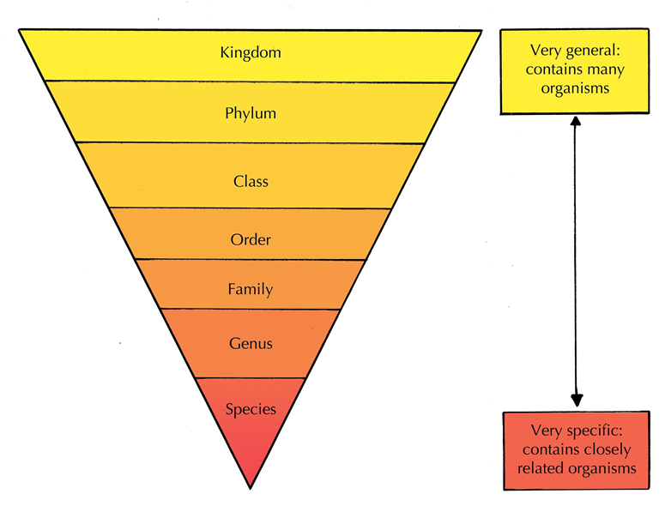
History of Classification
Carl Linnaeus (1707-1778) introduced the Linnaean Classification System →
Carl Woese (1990) suggested bacterial kingdom Monera be split into two domains and the third domain contain all other organisms
Thomas Cavalier-Smith (1998) suggested kingdom Plantae be split into two kingdoms because of differences in cells

Slide 6
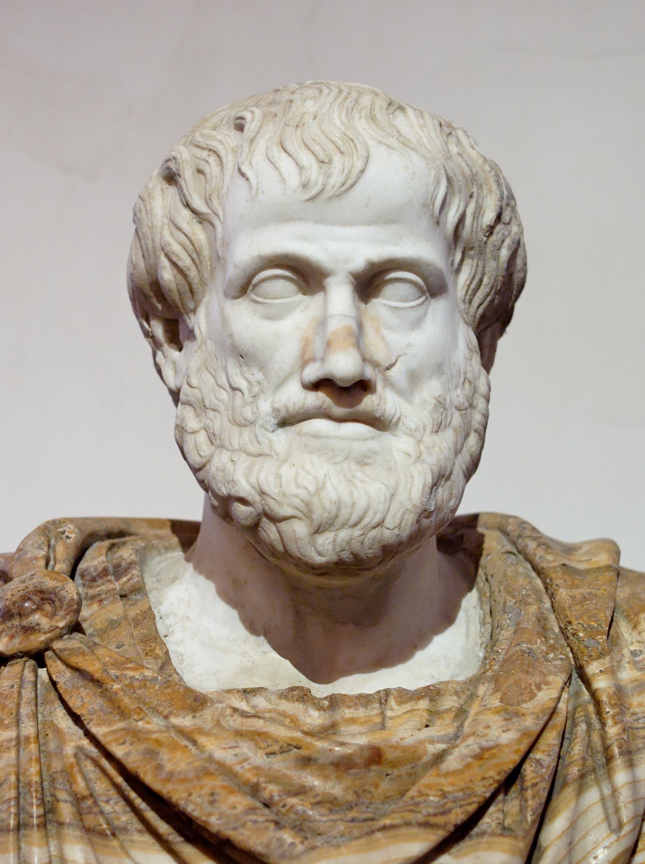
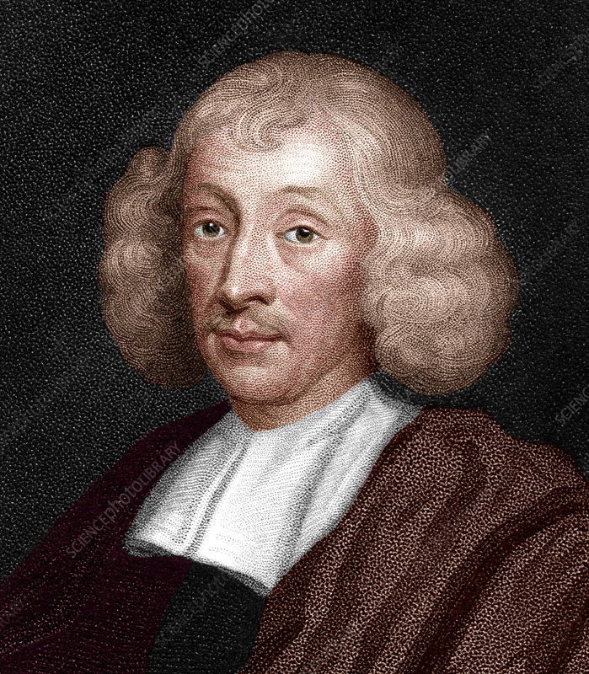
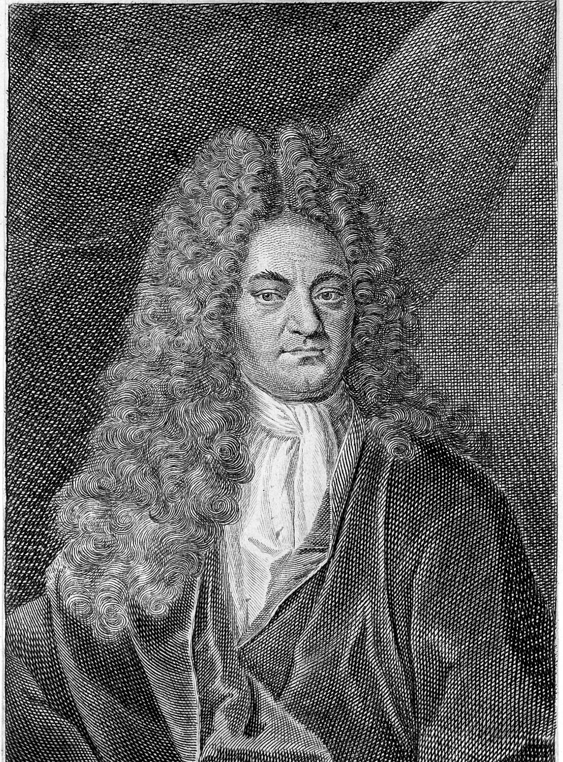
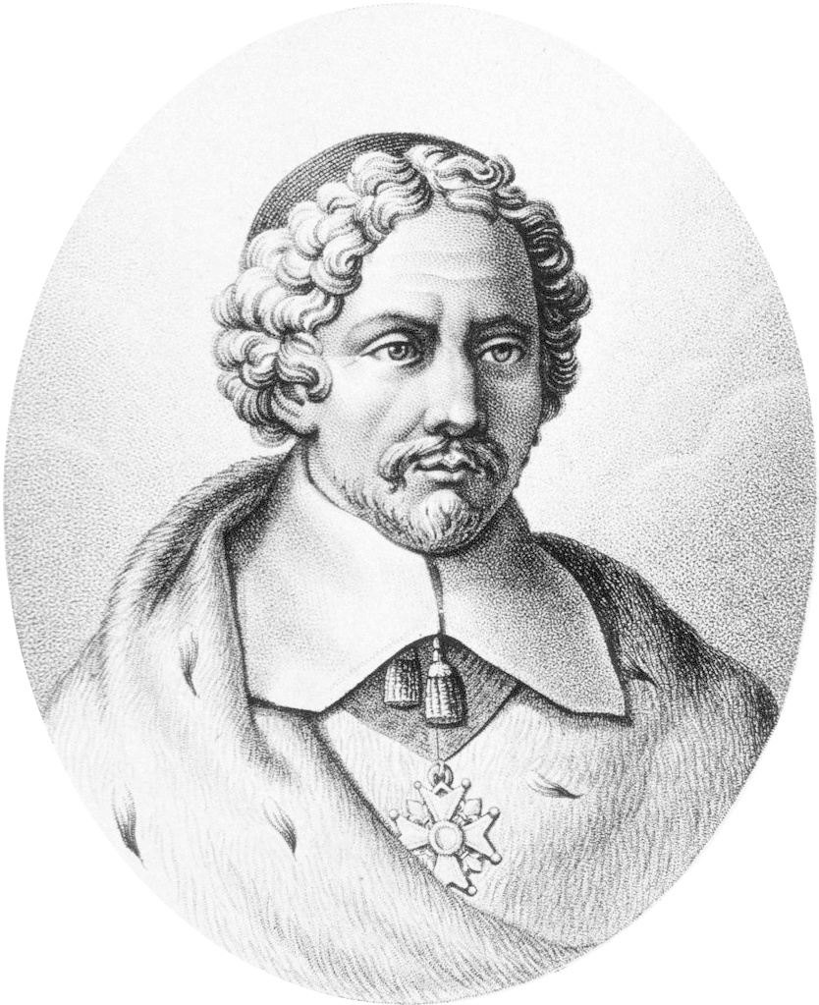
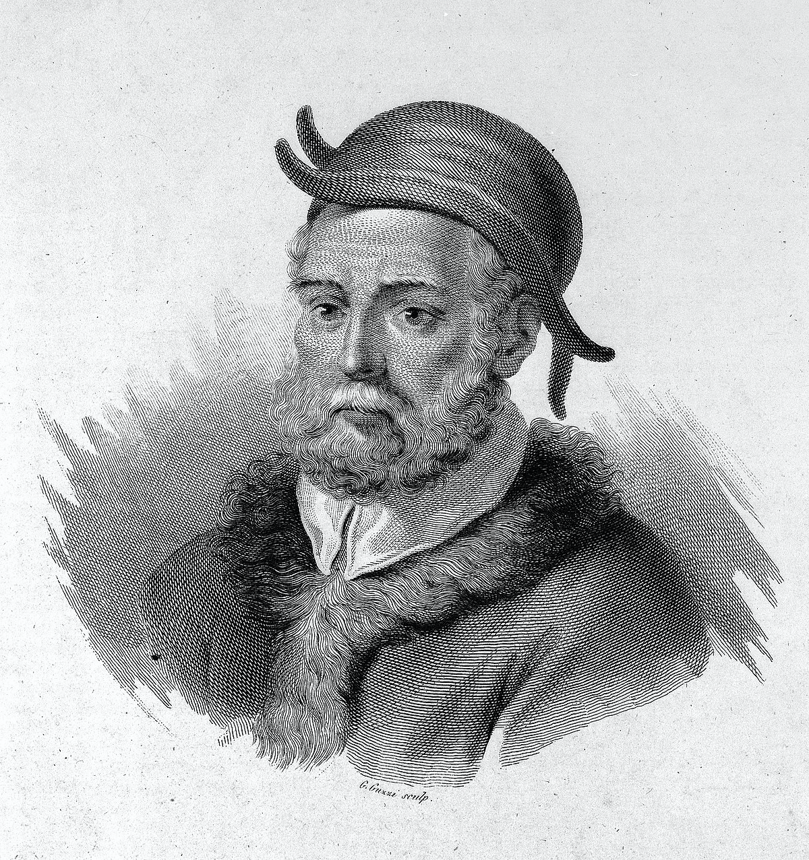

History of Classifications Timeline
384-322 BC
1519-1603
1627-1723
1652-1723
1656-1708
Andrea Caesalpino
Augustus Quirinus Rivinus
Joseph Pitton de Tournefort
Aristotle
John Ray
Ordered samples from least important (e.g., rocks) to most important (e.g., animals, women and men, kings, god).
Suggested classifying plants into groups according to their trunk and fruits.
Suggested that organisms needed to be observed over their entire lifespan.
Augustus Quirinus Rivinus (1652-1723) & Joseph Pitton de Tournefort (1656-1708) suggested using a hierarchy of names for each organism that describes the characteristics of each level of the hierarchy.
* Student Task: Copy down the information above *

Slide 7
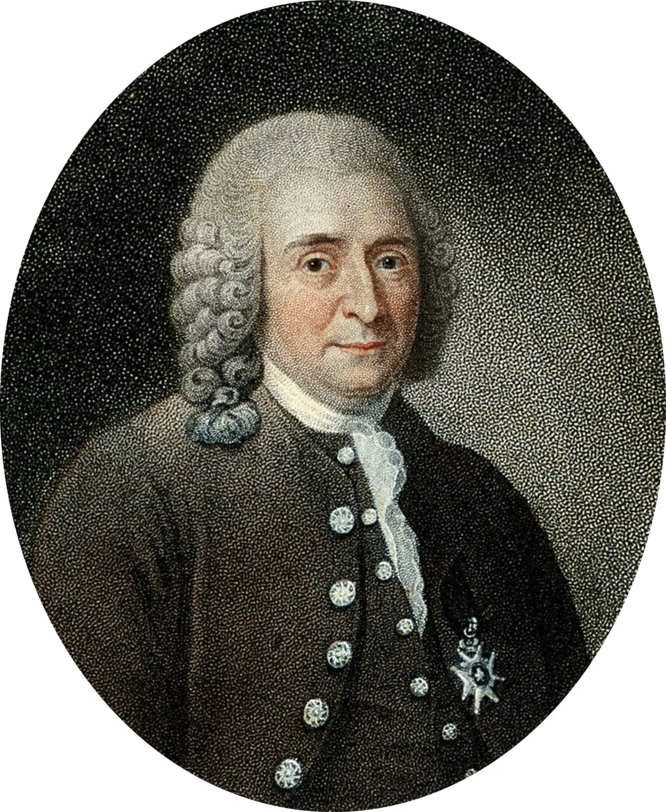
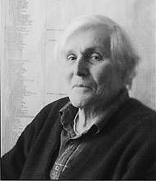
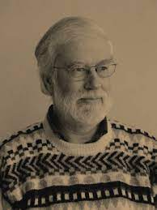
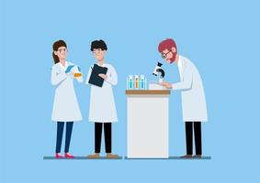


History of Classifications Timeline
1707-1778
1900
1998
What do we use?
2022
Carl Linnaeus
Carl Woese
Thomas Cavalier-Smith
Introduced the Linnaean Classification System.
Suggested bacterial kingdom Monera be split into two domains and the third domain contain all other organisms.
Suggested kingdom Plantae be split into two kingdoms because of differences in cells.
* Student Task: Copy down the information above *

Slide 8
Classifications Hierarchy
“King Philip Crawled Over Four Gooey Snails”
Kingdom
Phylum
Class
Order
Family
Genus
Species
* Student Task: Copy down the information above *

Slide 9
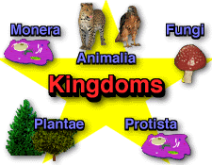
The 5 Kingdoms
Protista
→ Comprises mostly single-celled organisms such as the protozoa, simple algae and fungi & slime moulds
Fungi
→ Eukaryotic organisms that include microorganisms such as yeasts, moulds and mushrooms
Plantae
→ Compassed all living things that were not animals, such as plants
Animalia
→ Kingdom Animalia is a vast kingdom comprised of eukaryotic, multicellular, heterotrophic creatures.
Monera
→ Single-celled organisms without a cell nucleus, such as bacteria
* Student Task: Copy down the information above *
“King Philip Crawled Over Four Gooey Snails”

Slide 10
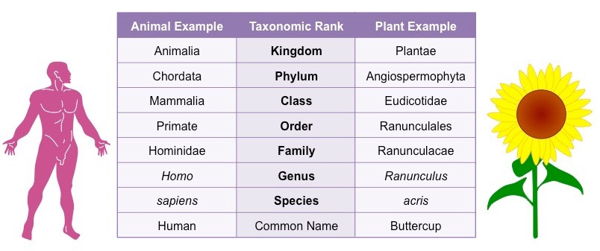
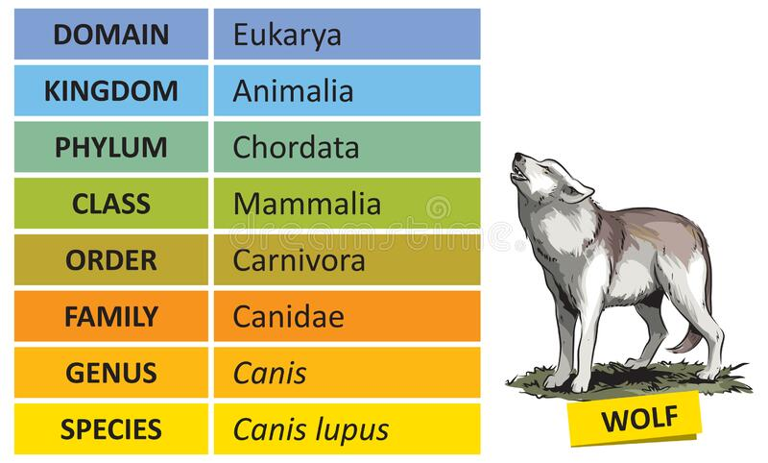
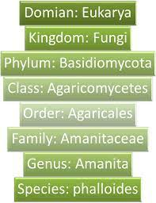
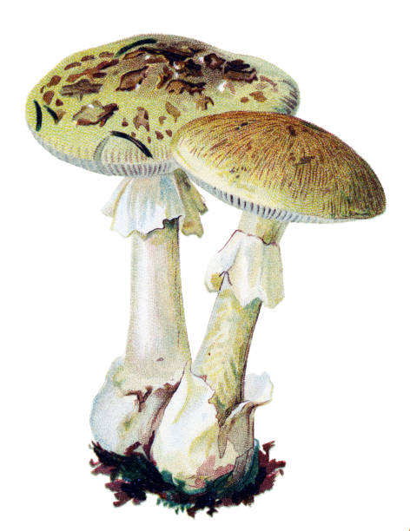
Classification Hierarchy Examples
Sunflower
Wolf
Mushroom

Slide 11
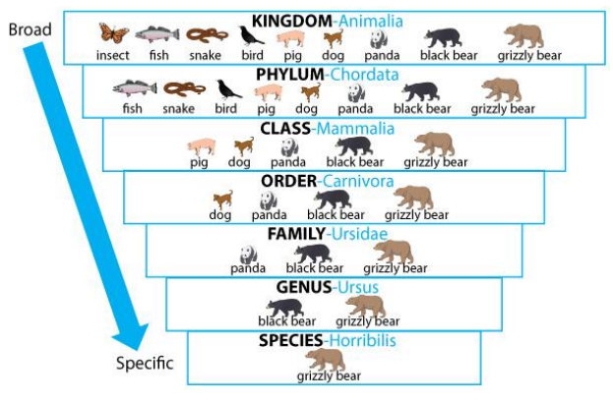
Classification Hierarchy Examples

Slide 12
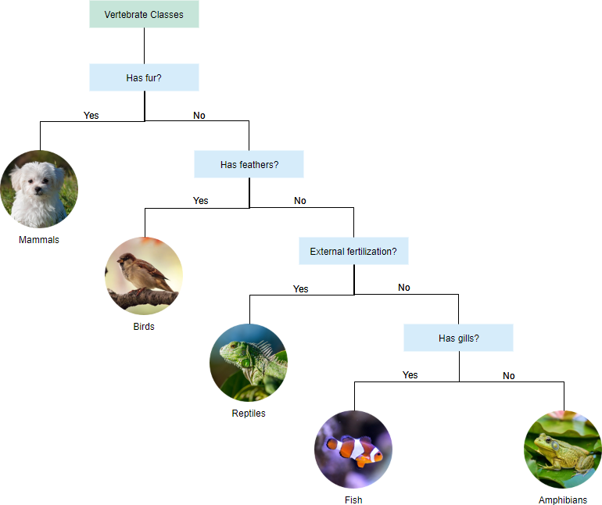
Scientific Naming
Dichotomous Key
Is a key for the identification of organisms based on a series of choices between alternative characters.
* Student Task: Copy down the information above *

Slide 13
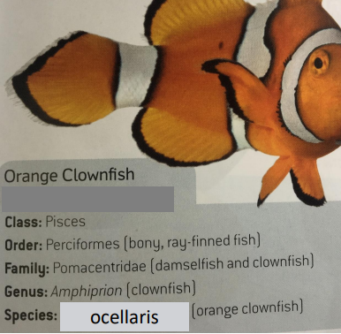

Scientific Naming
Linnaeus’s Double-Name ‘Binomial’ System
In this system the Genus group name always starts with a capital letter. The second word is the species name and does not have a capital letter.
Genus:
Is the category that groups organisms with common features.
Species:
Group of organisms that look like each other, can breed in natural conditions and produce fertile young.
* Student Task: Copy down the information above *

Slide 14
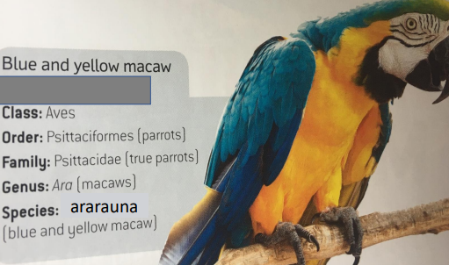
Linnaeus’s Double-Name System Example
Genus:
Ara
Species:
ararauna
Therefore the scientific name for the Blue and Yellow Macaw is:
“Ara ararauna”
* Student Task: Copy down the information above *

Slide 15
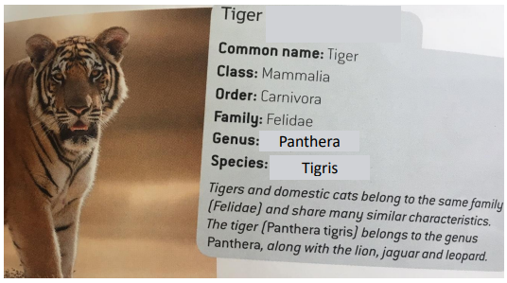
Your Turn!
Genus:
???
Species:
???
Therefore the scientific name for the Tiger is:
“ ”
* Student Task: Copy down the information above *

Slide 16
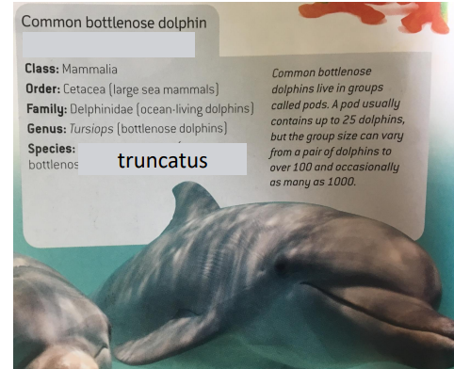
Your Turn!
Genus:
???
Species:
???
Therefore the scientific name for the Bottlenose Dolphin is:
“ ”
* Student Task: Copy down the information above *

Slide 17
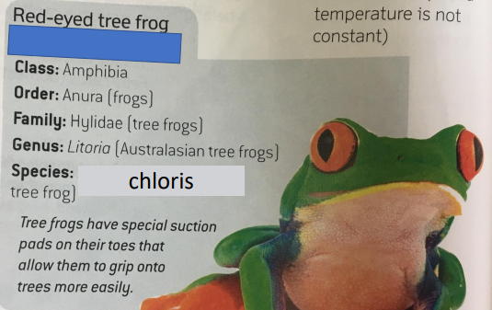
Your Turn!
Genus:
???
Species:
???
Therefore the scientific name for the Red-eyed Tree Frog is:
“ ”
* Student Task: Copy down the information above *

Slide 18
Why is it important to find new species and classify them?
EXAMPLES
The antibiotic penicillin (used to defend tonsilitis) was discovered from a type of mould.
Aspirin (used to relieve mild or chronic pain and to reduce fever and inflammation when unwell) comes from a substance in the bark of willow trees.
Many of the medications we currently use come from organisms.
* Student Task: Copy down the information above *

